Slide 1


BAZAAR STORES
TEAM 4

Slide 2



THROUGH MANAGER
The Store Manager must have full CRUD control over the product catalog to ensure continuous market relevance. This allows the manager to successfully add (US11), edit (US12), and delete (US13) products immediately, maintaining real-time accuracy and optimizing sales without fail.

Slide 3
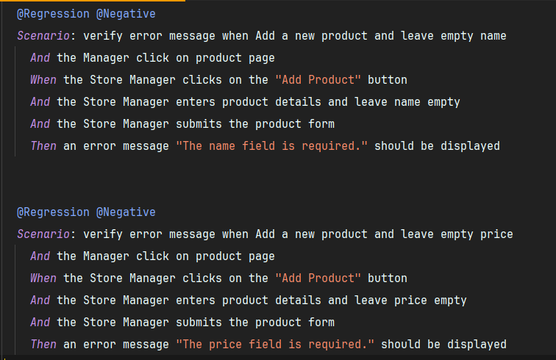
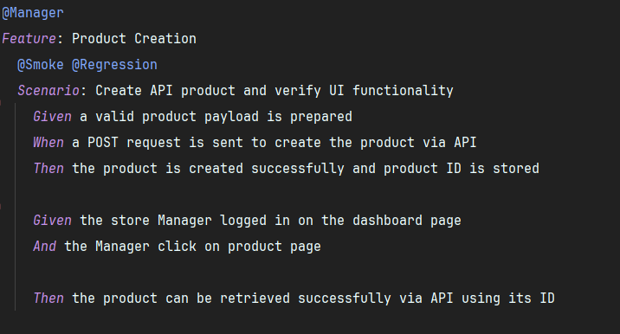
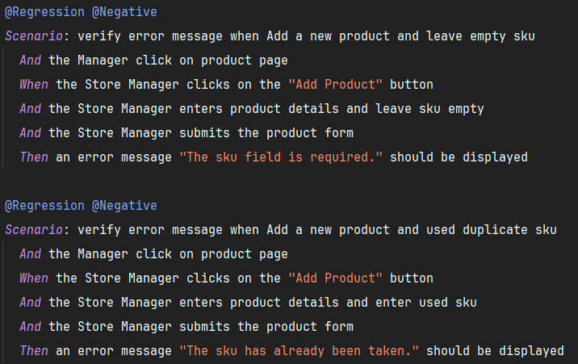
MANAGER 1. ADD NEW PRODUCT

Slide 4
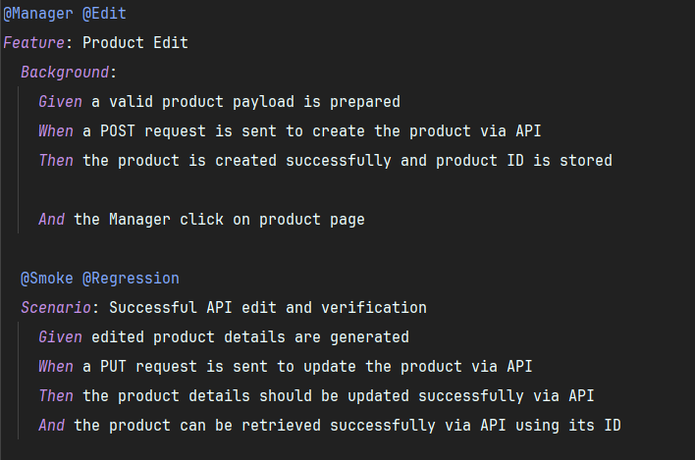
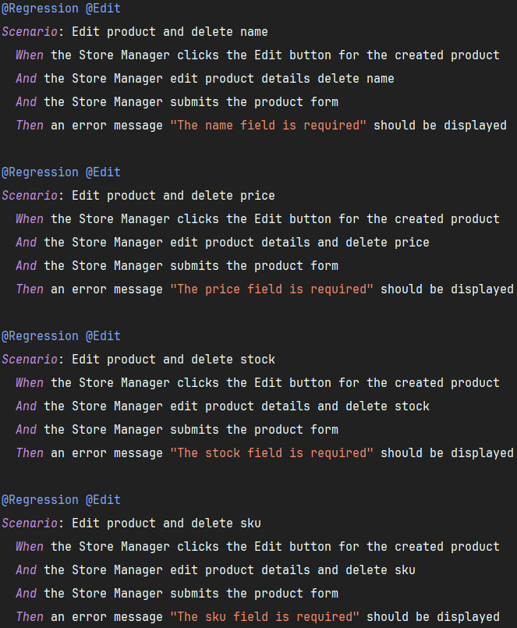
MANAGER 2. EDIT PRODUCT

Slide 5
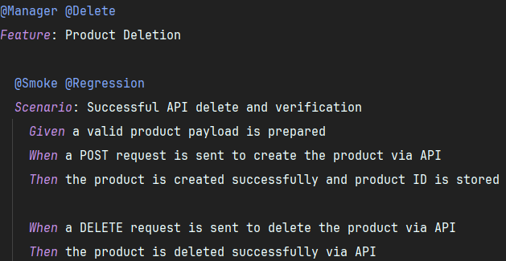
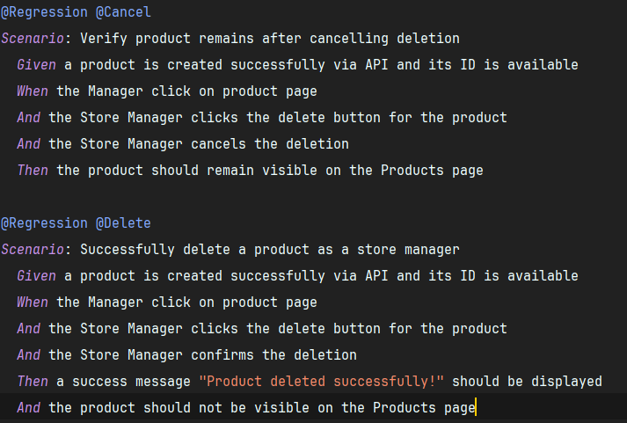
MANAGER 2. DELETE

Slide 6
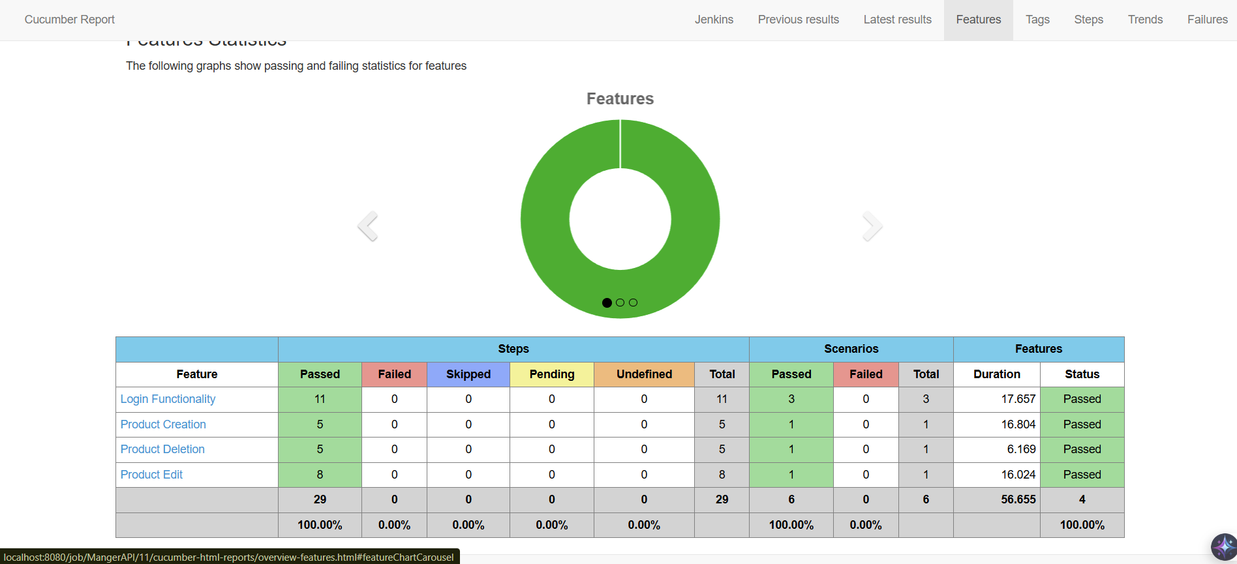
MANAGER
REPORT

Slide 7
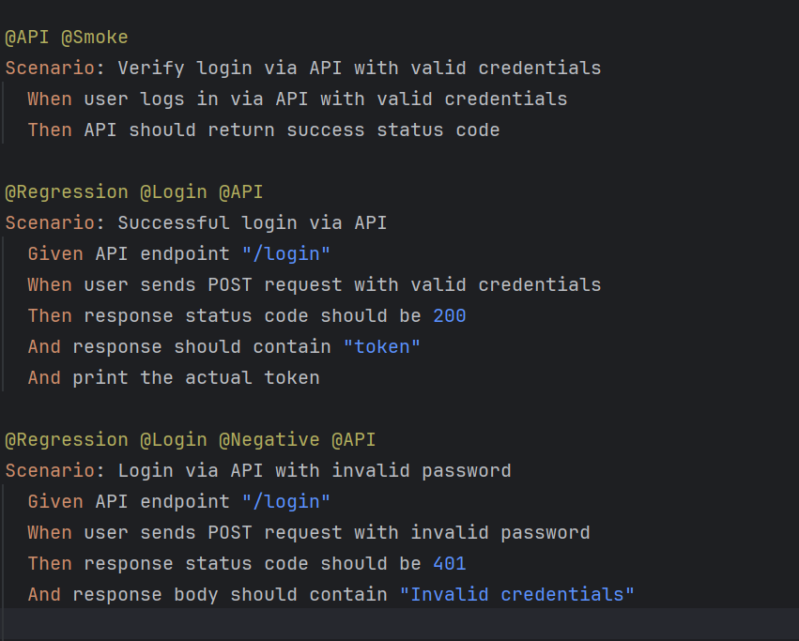
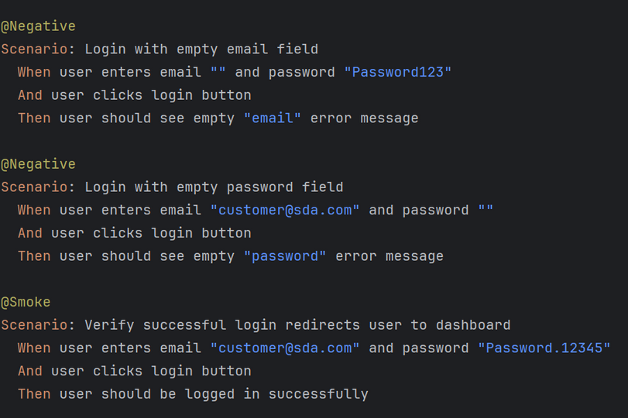

LOGIN UI & API
USER STORIES & IMPLEMENTED FEATURES
User Stories
US02 -Log in as a user to access the platform.
US06 – Add products to the cart
US08 – View items in the cart
US09 – Confirm items in the cart
implemented Features
Login Functionality: Valid & invalid login scenarios + API login
Cart Functionality: Add, view, remove, confirm items; hover actions
Customer Cart API: Add/View/Remove/Clear products via API

Slide 8
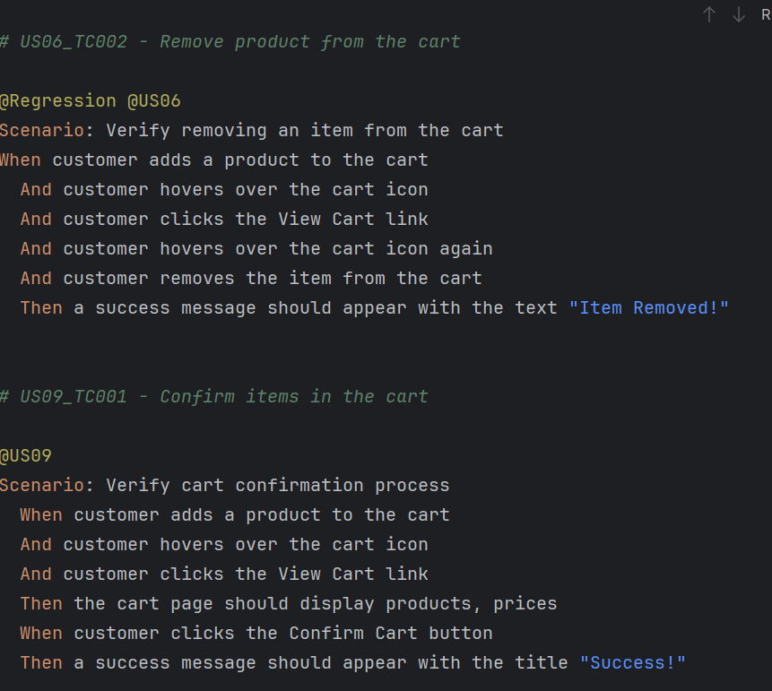
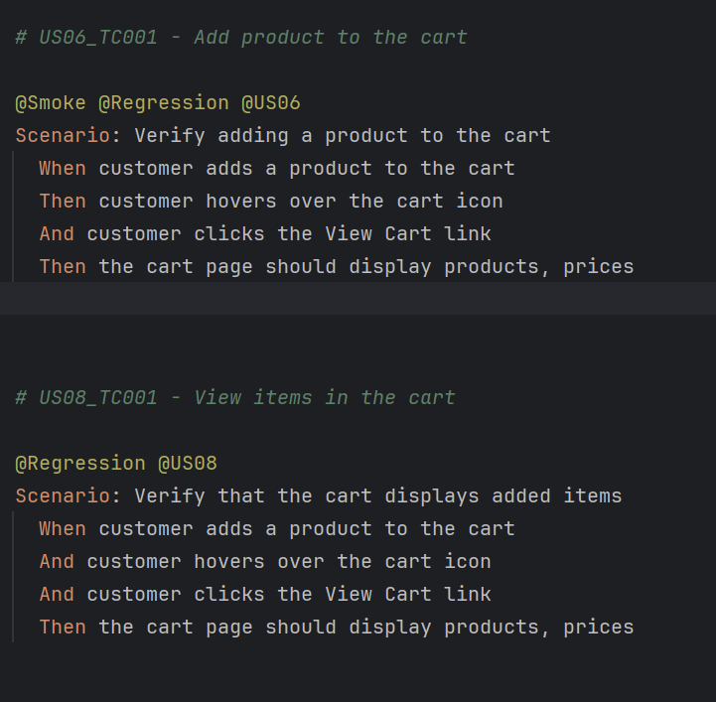
USER STORIES & IMPLEMENTED FEATURES
VIEW & DELEATE & ADD TO THE CART

Slide 9
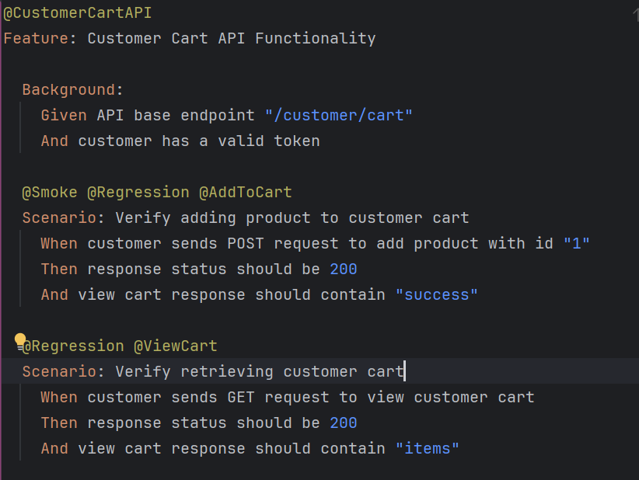
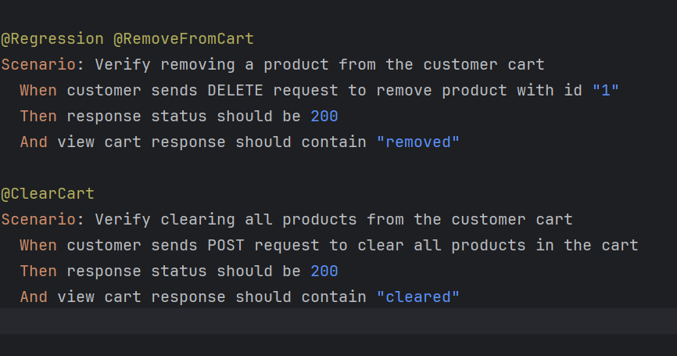
USER STORIES & IMPLEMENTED FEATURES
VIEW & DELEATE & ADD TO THE CART API

Slide 10

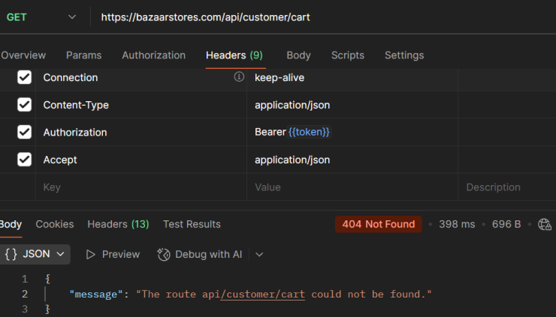
Arowwai Industries
Bullets for bugs
Screenshot of failed API request
Customer Cart GET request returns "route could not be found"
User cannot add the same product more than once
Other Challenges
Coordinating API and frontend for dynamic cart updates.
Hover actions for removing items (messages disappear fast)
BUGS & CHALLENGES

Slide 11
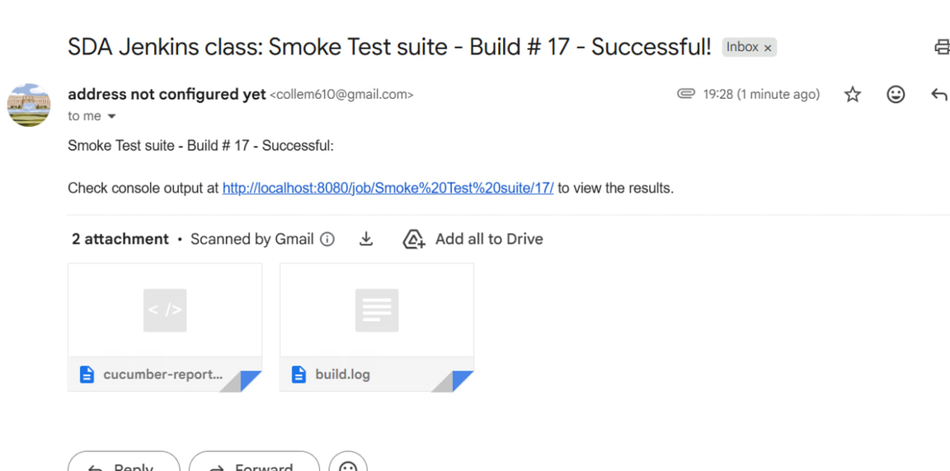
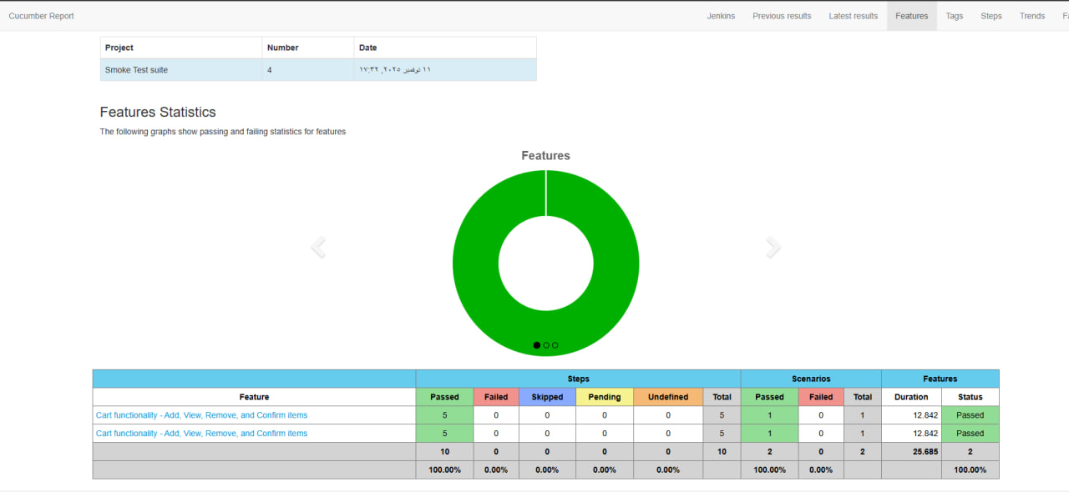
TEST AUTOMATION
Smoke Test & Regression Test Suite for Login & Cart
Jenkins run with email report

Slide 12
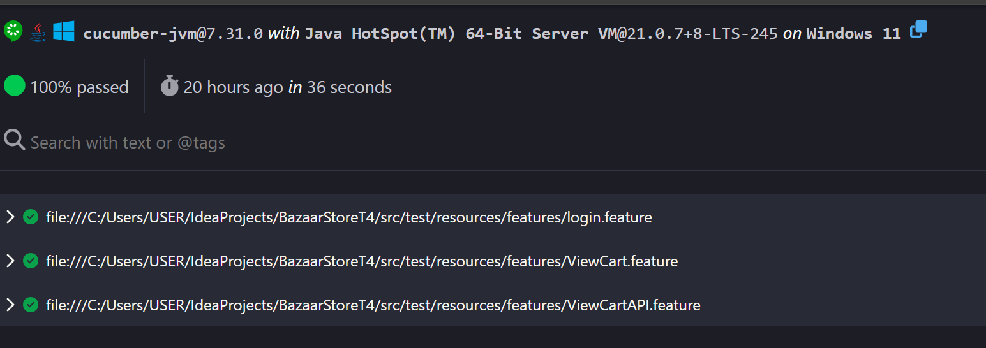
TEST AUTOMATION

Slide 13








TOOLS AND PLATFORMS

Slide 14
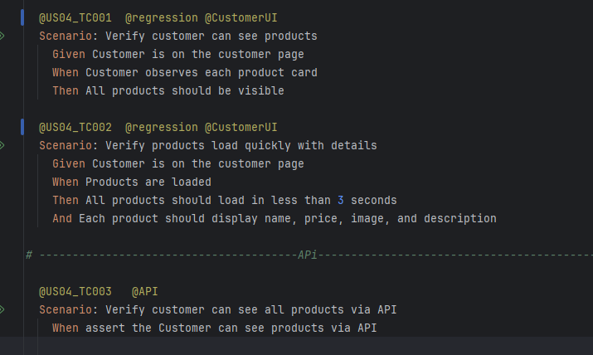
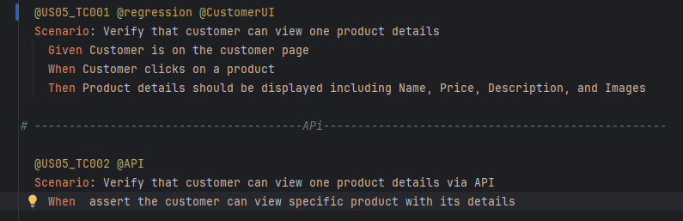
USER STORIES & IMPLEMENTED FEATURES
User Stories
US04 - Browse products as a customer
US05 - View product details as a customer
implemented Features
US04: Browse and view available products on the homepage.
US05: Display product details (name, price, description, images).

Slide 15
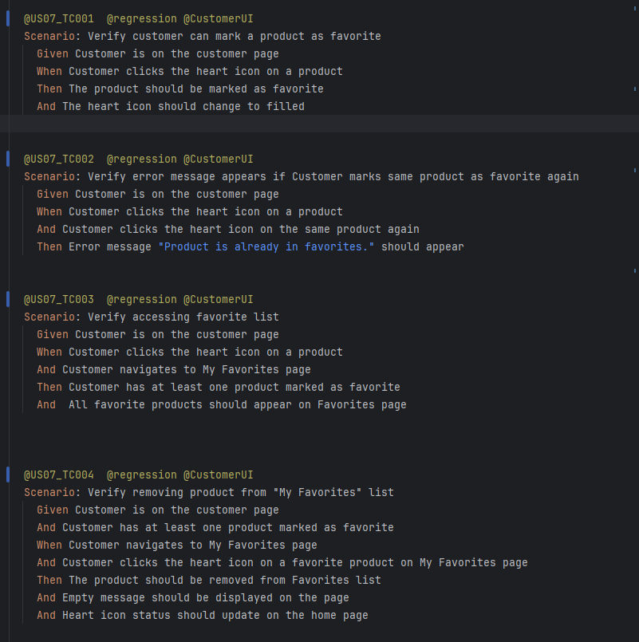
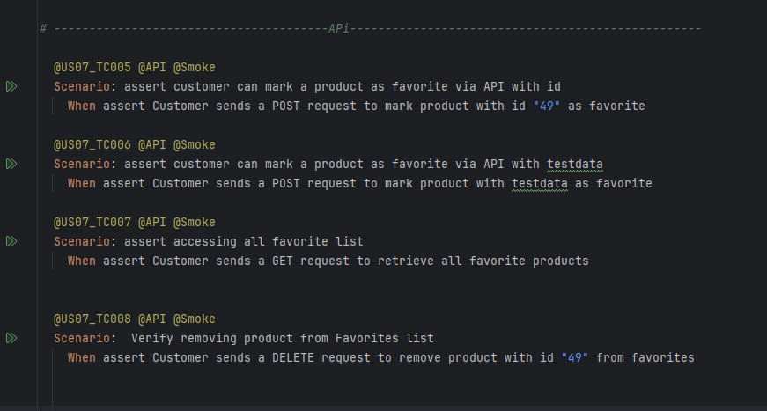
USER STORIES & IMPLEMENTED FEATURES
User Story
US07 - Mark products as favorites as a customer
implemented Features
US07: Add/remove products to Favorites and “get ” ,view them on “My Favorites” page.

Slide 16
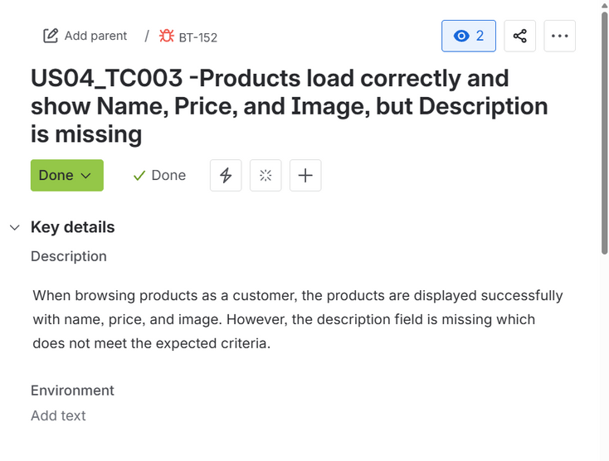
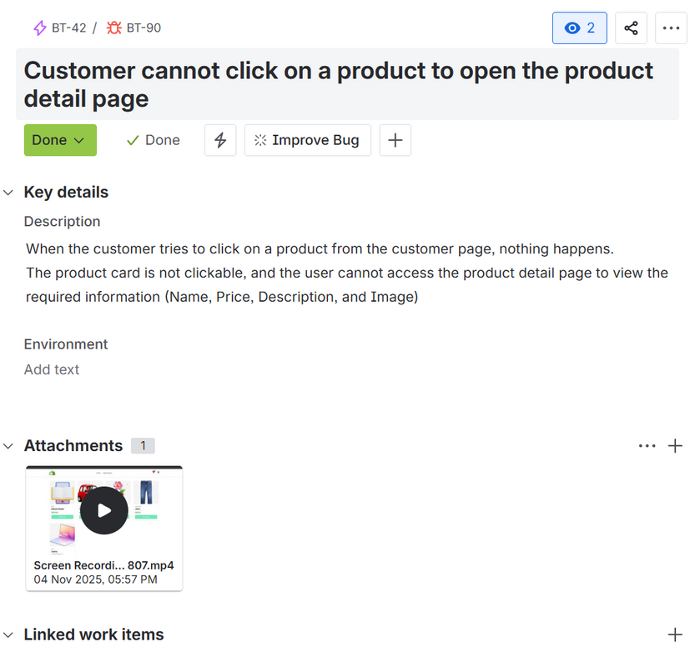
BUGS & CHALLENGES
Description is missing
No details page

Slide 17
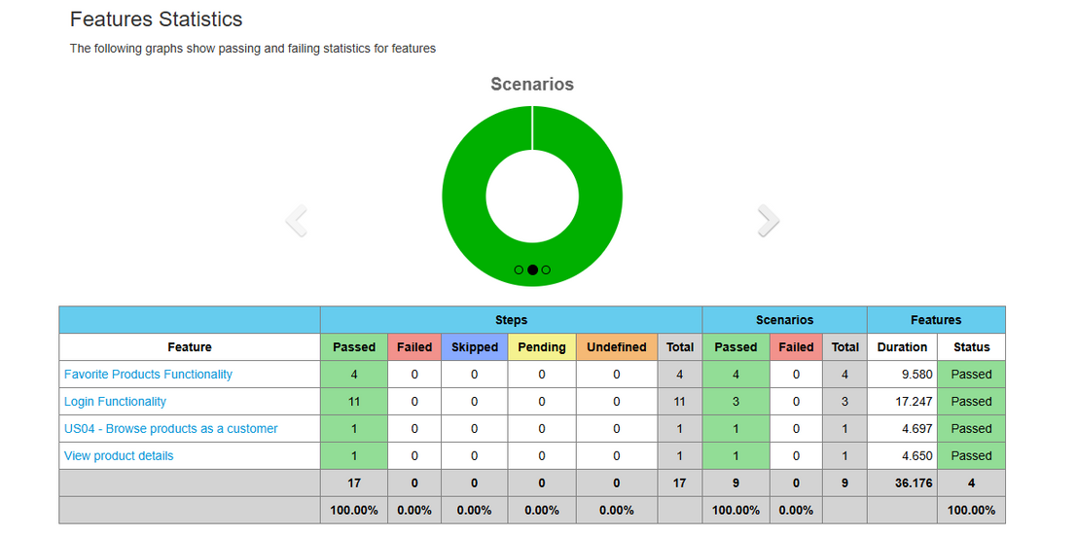
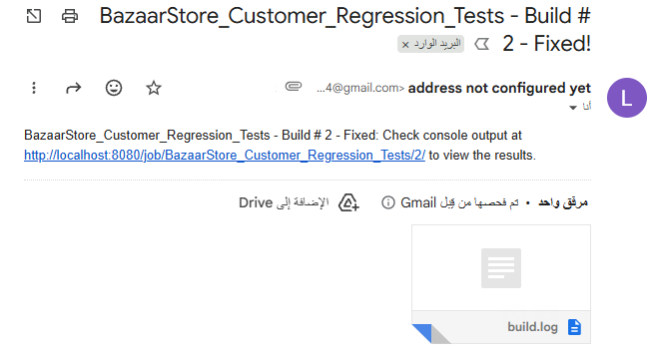
TEST AUTOMATION
Smoke Test & Regression Test Suite for Products & Favorites functionally
Jenkins run with email report

Slide 18
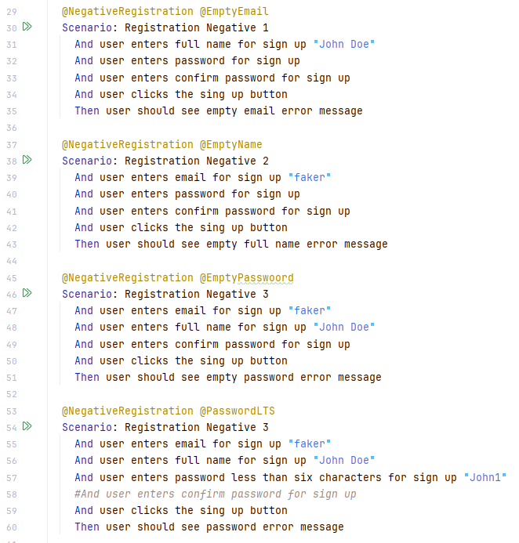
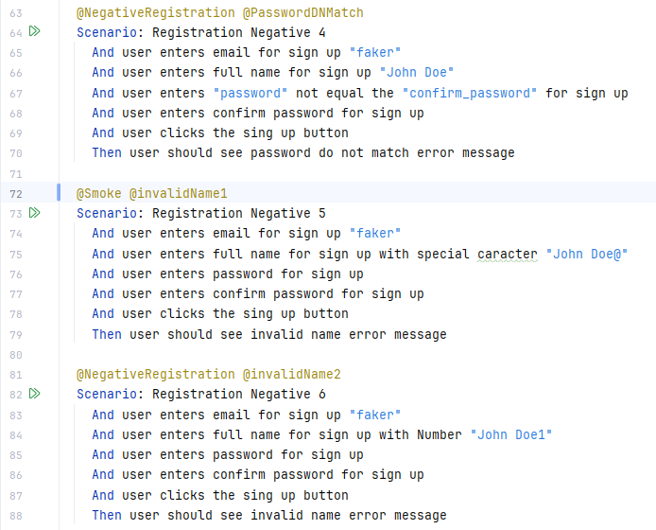
SCREENSHOTS OF MY IMPLEMENTED FEATURES
US01-Register an account as a new user.
US03-Log out of the platform as a user.
TC01-Verify successful account registration
TC02-Empty Name field
TC03-Empty Email field
TC04-Empty password field
TC05-Empty confirmation password field
TC06-The Email is written in invalid format
TC07-Name with special caracter
TC08-Name with Number
TC09-Password less than 6 charcters
TC10-Password and confirm password do not match
TC11-verification of successful account creation
TC01-click "Log Out"
TC02-Verify user is redirected to log in page after log out
TC03-Verify the user session is end securely

Slide 19
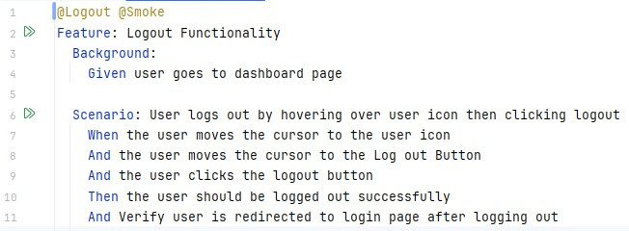
SCREENSHOTS OF MY IMPLEMENTED FEATURES
US01-Register an account as a new user.
US03-Log out of the platform as a user.
TC01-Verify successful account registration
TC02-Empty Name field
TC03-Empty Email field
TC04-Empty password field
TC05-Empty confirmation password field
TC06-The Email is written in invalid format
TC07-Name with special caracter
TC08-Name with Number
TC09-Password less than 6 charcters
TC10-Password and confirm password do not match
TC11-verification of successful account creation
TC01-click "Log Out"
TC02-Verify user is redirected to log in page after log out
TC03-Verify the user session is end securely

Slide 20
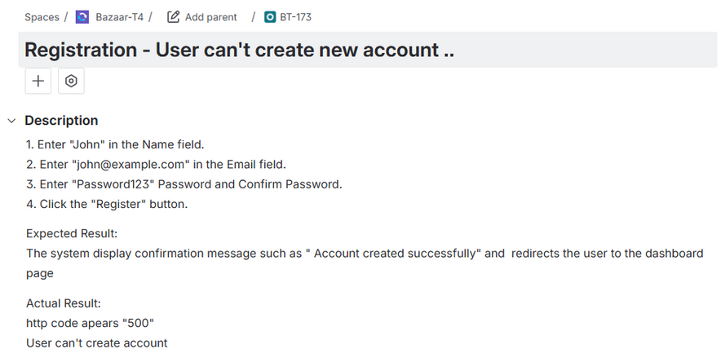
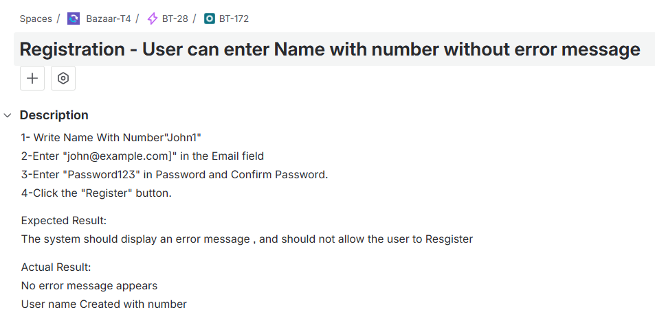
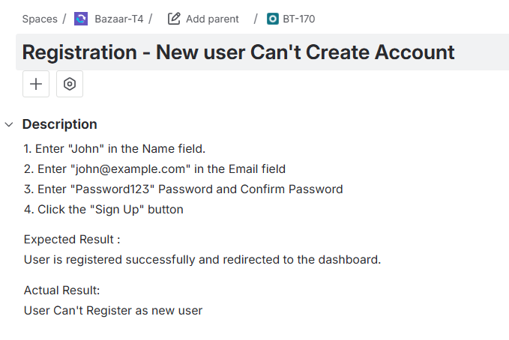
BUGS

Slide 21
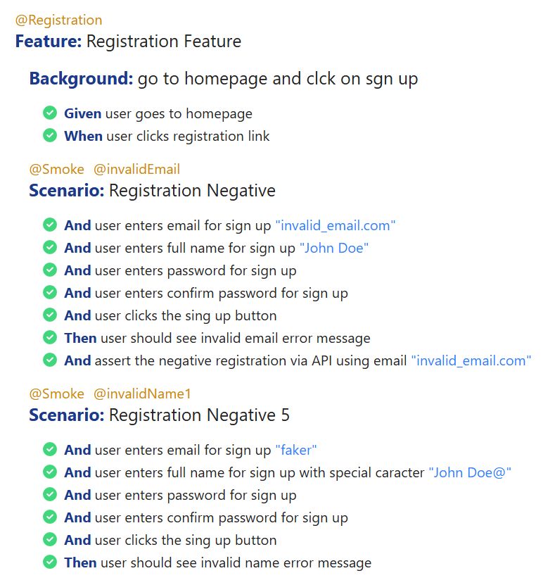
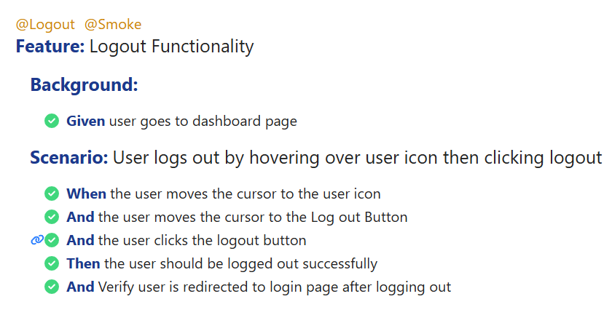
US01-Register an account as a new user.
REGRESSION TEST
US03-Log out of the platform as a user.

Slide 22
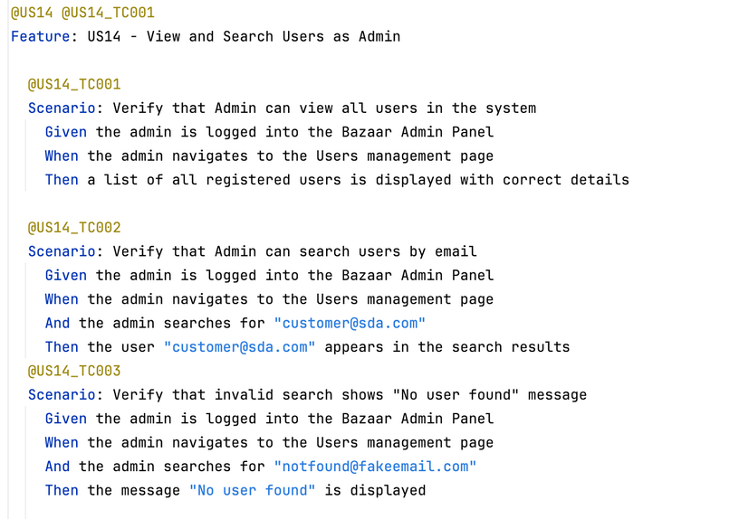
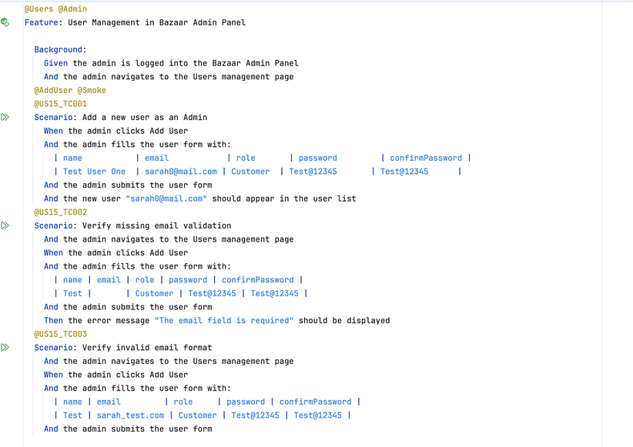
USER STORIES
USER STORIES
US14 - View all users in the system as an Admin
US15 - Add a new user as an Admin
TEST CASES
US14_TC001 - Verify that Admin can view all users in the system
US14_TC002 - Verify that Admin can search users by email
US14_TC003 - Verify that invalid search shows "No user found" message
US15_TC001 - Verify adding a new user with valid data
US15_TC002 - Verify missing field validation
US15_TC003 - Verify invalid email format validation

Slide 23
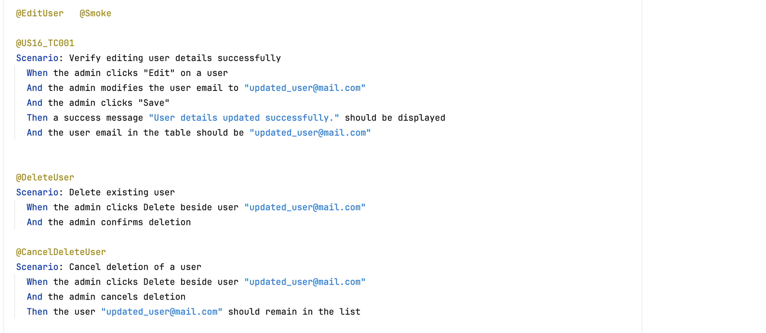
USER STORIES
USER STORIES
US16 - Edit existing user details as an Admin
US17 - Delete a user as an Admin
TEST CASES
US16_TC001 - Verify editing user details
US17_TC001 - Verify deleting user from list
US17_TC002 -Verify canceling delete action

Slide 24
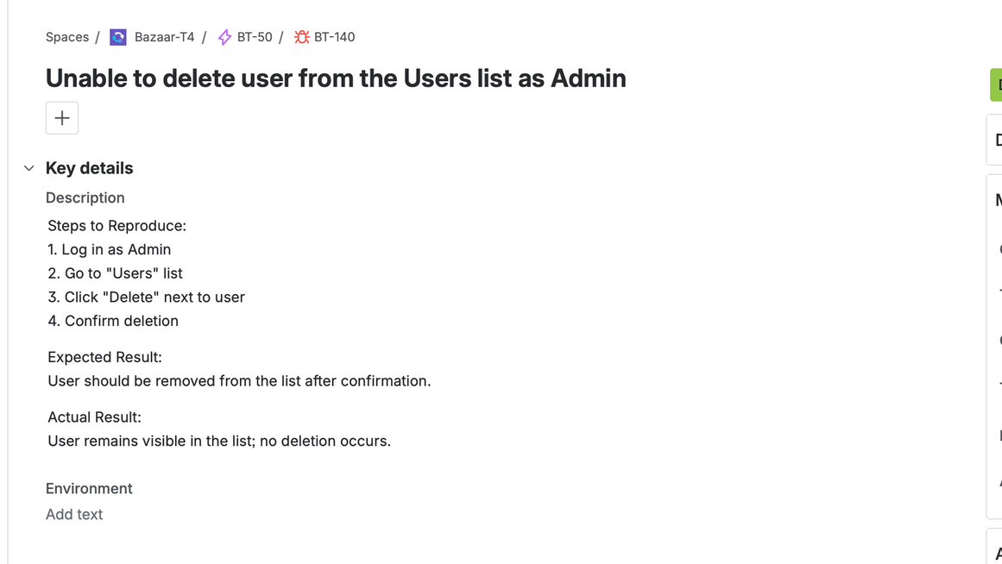
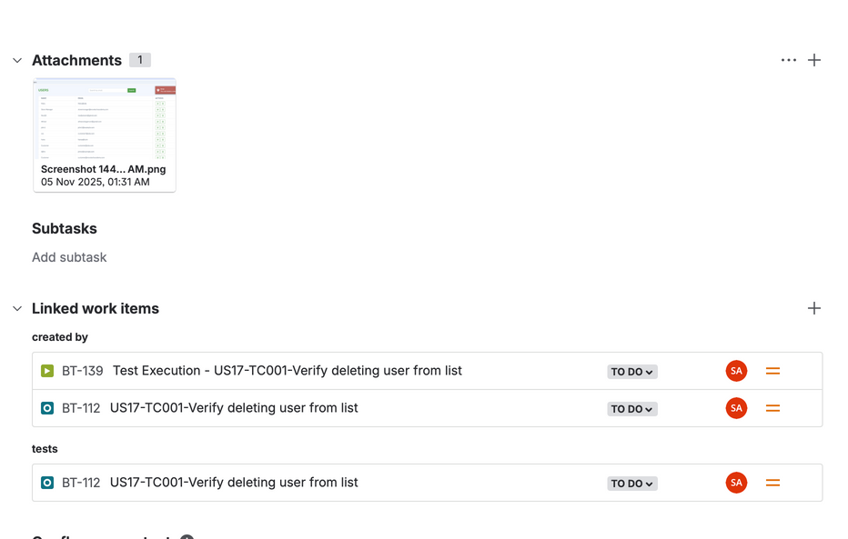
BUGS
Bug: Unable to delete user from Users list

Slide 25
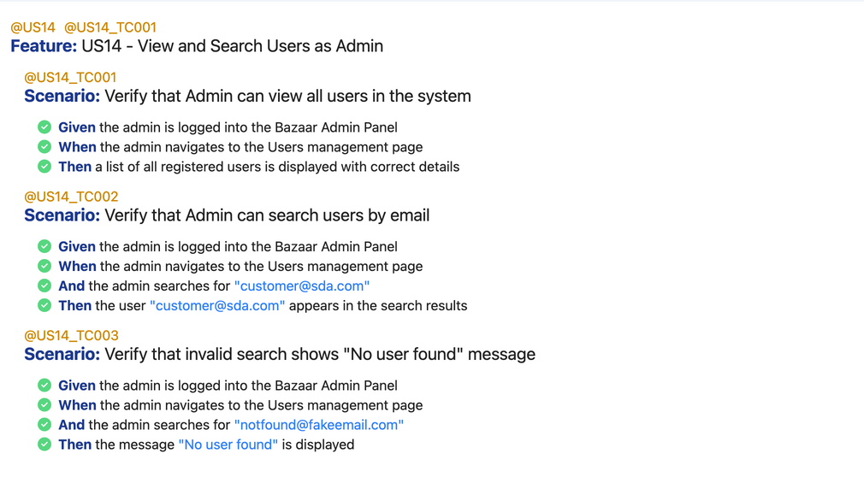
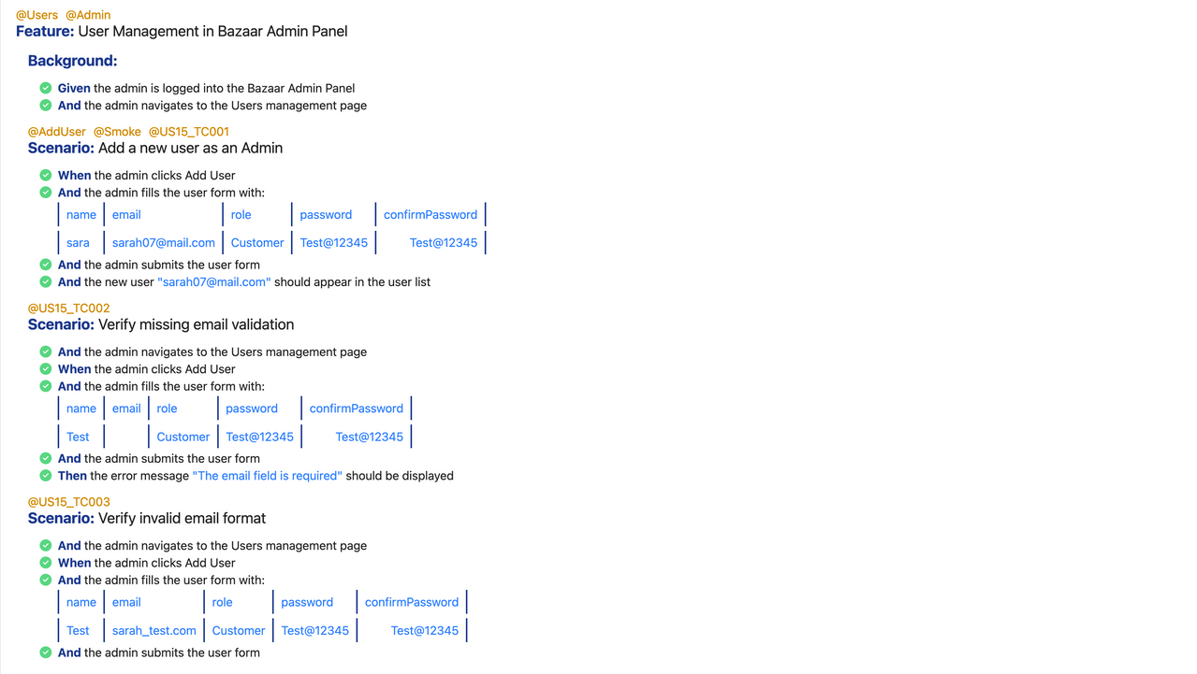
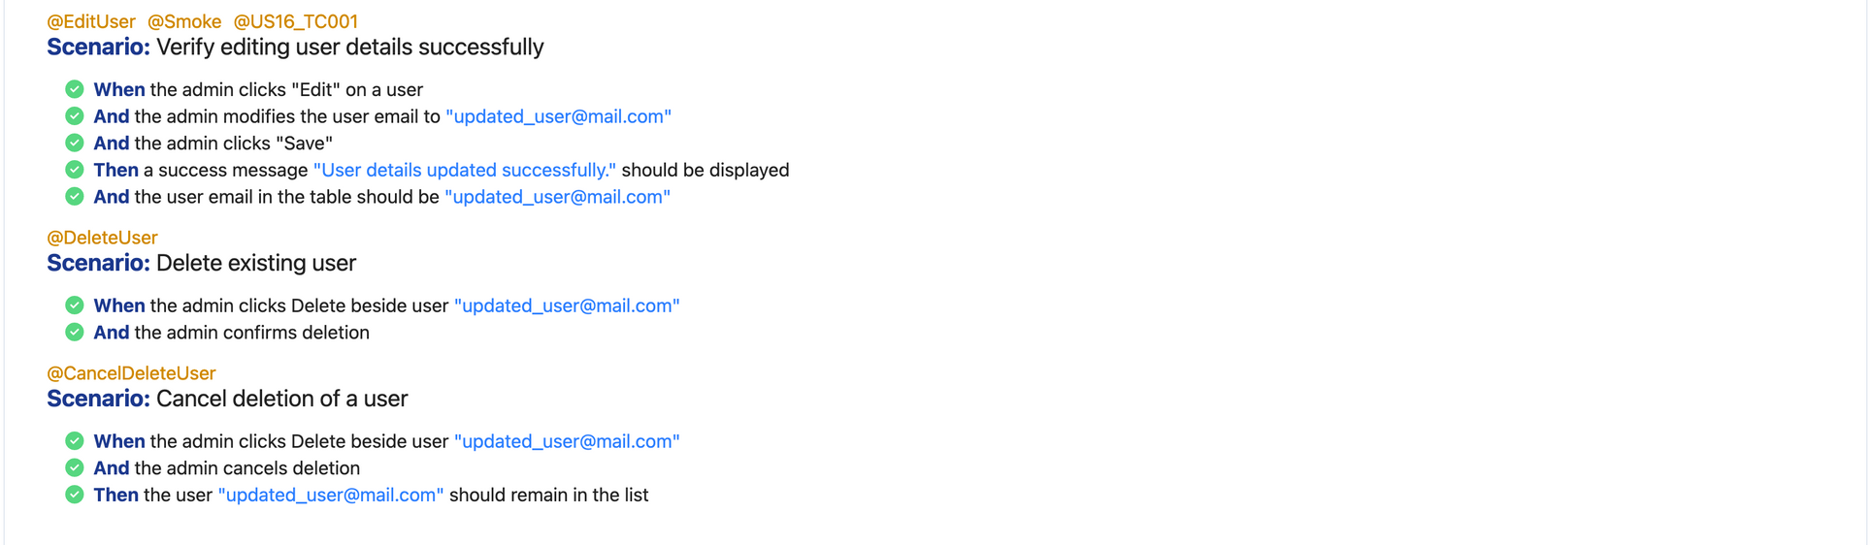
TEST AUTOMATION
Smoke Test & Regression Test Suite for Products & Favorites functionally

Slide 26
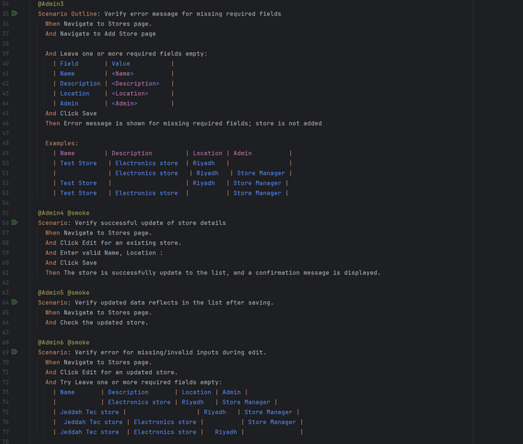
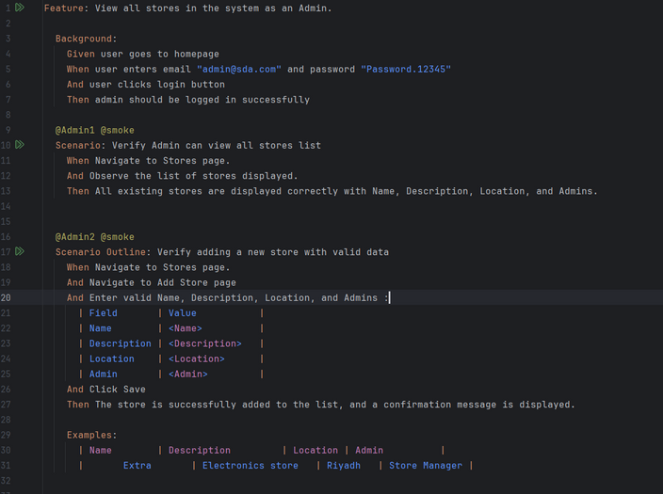
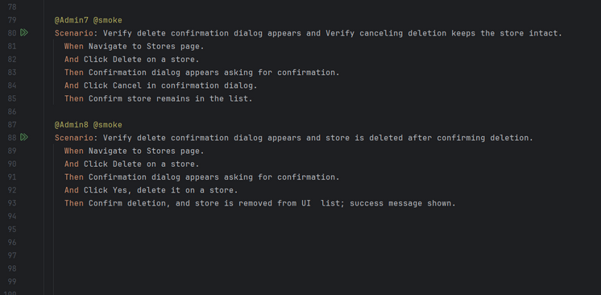
USER STORIES
USER STORIES
TEST CASES
US18 - View all stores in the system as an Admin.
US19 - Add a new store as an Admin.
US20 - Edit existing store details as an Admin.
US21- Delete a store as an Admin.
US18_TC001 - Verify Admin can view all stores list.
US19_TC001 - Verify adding a new store with valid data.
US19_TC002 - Verify error message for missing required fields.
US20_TC001 - Verify successful update of store details.
US20_TC003 - Verify error for missing/invalid inputs during edit.
US20_TC005 - Verify updated data reflects in the list after saving.
US21_TC001 - Verify delete confirmation dialog appears.
US21_TC003 - Verify store is deleted after confirming deletion.
US21_TC005 - Verify canceling deletion keeps the store intact.

Slide 27
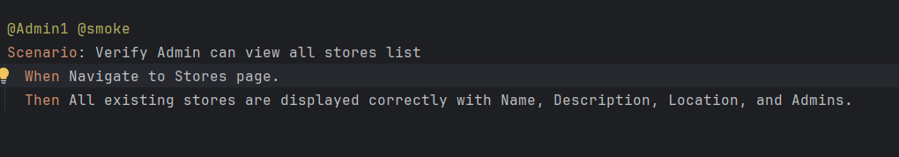
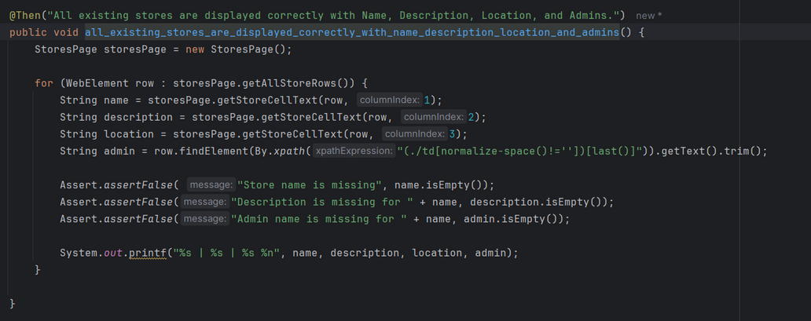
TEST AUTOMATION
User Stories and Functional Highlights
US18_TC001 - Verify Admin can view all stores list.

Slide 28
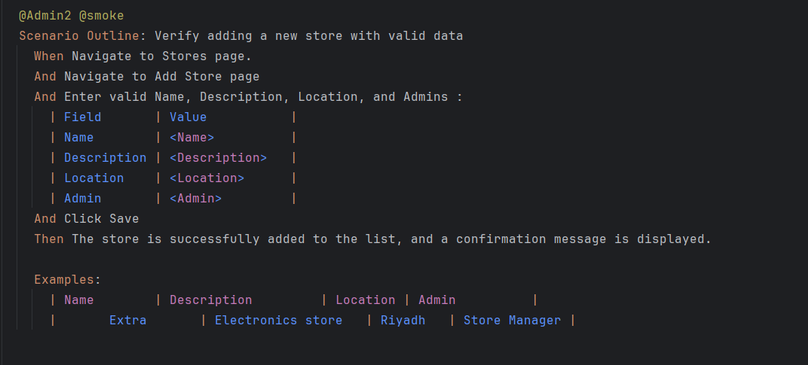
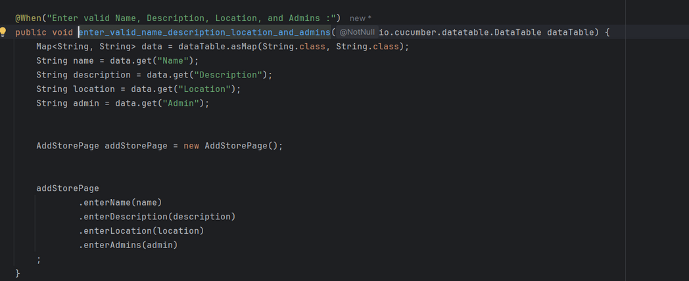
TEST AUTOMATION
User Stories and Functional Highlights
US19_TC001 - Verify adding a new store with valid data.

Slide 29
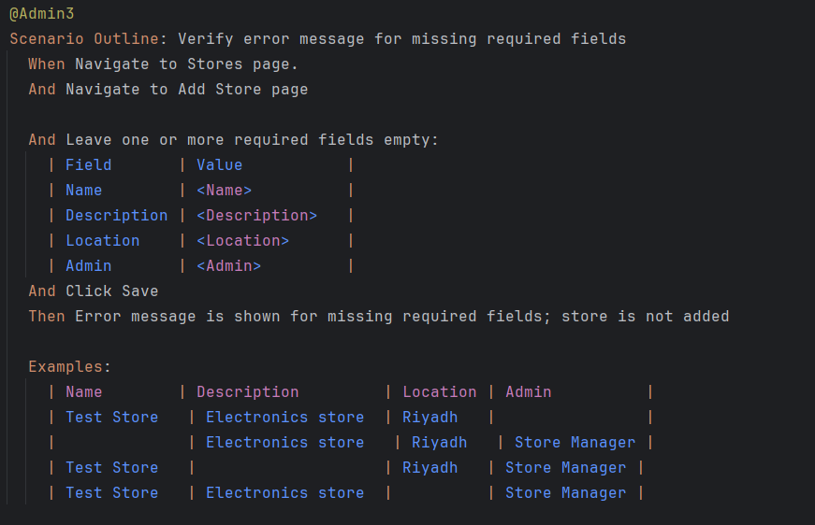

TEST AUTOMATION
User Stories and Functional Highlights
US19_TC002 - Verify error message for missing required fields.

Slide 30



TEST AUTOMATION
User Stories and Functional Highlights
US20_TC001 - Verify successful update of store details.

Slide 31



TEST AUTOMATION
User Stories and Functional Highlights
US20_TC005 - Verify updated data reflects in the list after saving.

Slide 32



TEST AUTOMATION
User Stories and Functional Highlights
US20_TC003 - Verify error for missing/invalid inputs during edit.

Slide 33



TEST AUTOMATION
User Stories and Functional Highlights
US21_TC001 - Verify delete confirmation dialog appears.
US21_TC005 - Verify canceling deletion keeps the store intact.

Slide 34



TEST AUTOMATION
User Stories and Functional Highlights
US21_TC003 - Verify store is deleted after confirming deletion.

Slide 35


TEST AUTOMATION
Smoke Test

Slide 36

THANK YOU
SADEEM ABDULAZIZ
ABDULLAH BATARFI
SARAH HAKAMI
FATIMA AL-HAMMAM
LINA AL-HUMAIDI
GHADEER AHMED
Arowwai Industries

